Slide 1

ENHANCING DATA SECURITY
USING DIGITAL
WATERMARKING
By
Nayan S. Thorat (66)
Prathamesh A. Yelne (74)
Zibal A. Khan (30)
Om V. Ubhad (70)
Shraddha V. Jaiswal (25)
Guide
Mr. Chetan R. Ingole
Department of Computer Science and Engineering
Prof Ram Meghe College of Engineering and Management
Badnera-Amravati, India.
2022-2023

Slide 2

Content
Introduction
Origin of Name “Digital Watermarking”
Objective of this Project
Literature Analysis
Algorithms
Technology and Platform to be used
AFD, DFD and CFD
Application of Digital Watermarking
Conclusion
Demonstrate of this project (Optional)
References

Slide 3

Introduction
Digital Watermark is a mark or, in many cases, a piece of code embedded into digital data (videos, pictures, or even audio). Digital watermarks, also known as forensic watermarks. Digital watermarks protect the piece of digital media and prevent copyright infringement.

Slide 4


Origin of Name “Digital Watermarking”
The term "Digital Watermark" was coined by Andrew Tirkel and Charles Osborne in December 1992. The first watermarks appeared in Italy during the 13th century, but their use rapidly spread across Europe.
Andrew Tirkel
Charles Osborne

Slide 5
Objective of this Project
To prevents data leakage
To protects copyright of multimedia data
To protects databases and text files.
To provide secret communication between one organization to other organization
To hide a message related to the actual content in the form of digital signal (Morse Code)

Slide 6
Literature Analysis
Reference | Basic concept | Database | Keywords | Claim by Authors
[1] Jaishri Huru, Hemant Damecha (2014) | Watermarking Algorithms for Digital Image | Embedded Data | Reduction of image size, lossy compression of image, changing the contrast of the images | Watermarking are diverse and classified based on their visibility and robustness
[2] Mohan Durvey (2014) | Digital Watermarking | Embedded Data | Types of watermarks, Spatial watermarking, Frequency domain watermarking and Applications of watermarking | Protecting the digital media from unauthorized usage
[3] Abraham and Paul (2019) | An imperceptible spatial domain color image watermarking scheme | Embedded Data | Color image watermarking, Spatial domain, Watermark, Embedding, Extraction, Attacks | Watermark information over a region of pixels as implemented by the transform domain techniques.

Slide 7
Literature Analysis
Reference | Basic concept | Database | Keywords | Claim by Authors
[4] Sarita P. Ambadekar, Jayshree Jain and Jayshree Khanapuri | Digital Image Watermarking Through Encryption and DWT for Copyright Protection | Embedded Data | Image watermarking, Discrete wavelet, transform, Encryption, Copyright protection | Applied for copyright and content authentication applications.
[5] Zihan Yuan, Decheng Liu, Xueting Zhang, Qingtang Su (2020) | New image blind watermarking method based on two dimensional discrete cosine transform | Embedded Data | Digital image watermarking, Discrete cosine transform (DCT) | Application of watermarking with 2D
[6] I.J, Cox, J.Killian, F.T.Leighton, and T,Shamoon (1997) | Secure spread spectrum watermarking of multimedia | Embedded Data | Digital image watermarking, Image Processing | Spectrum watermarking

Slide 8
Algorithms
SHA - 256 Algorithm (data integrity)
2) AES Algorithm (database)
3) XOR Algorithm (binary operation)
4) RC6 Algorithm (block operation)

Slide 9

SHA 256 Algorithm
SHA-256 (Secure Hash Algorithm 256) is a cryptographic hashing algorithm (or function) that’s used for message, file, and data integrity verification. It’s part of the SHA-2 family of hash functions.

Slide 10
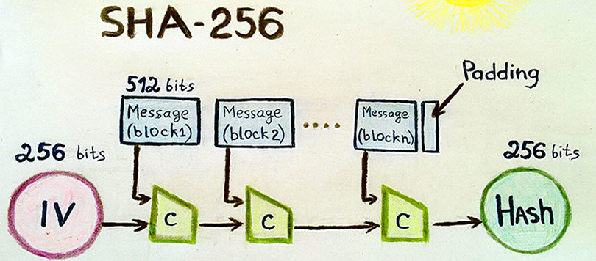
Working of SHA 256

Slide 11

AES Algorithm
AES (Advanced Encryption Standard) is a symmetric type of encryption which is used the same key for both encrypt and decrypt data. It is based on a substitution-permutation network, also known as an SP network

Slide 12
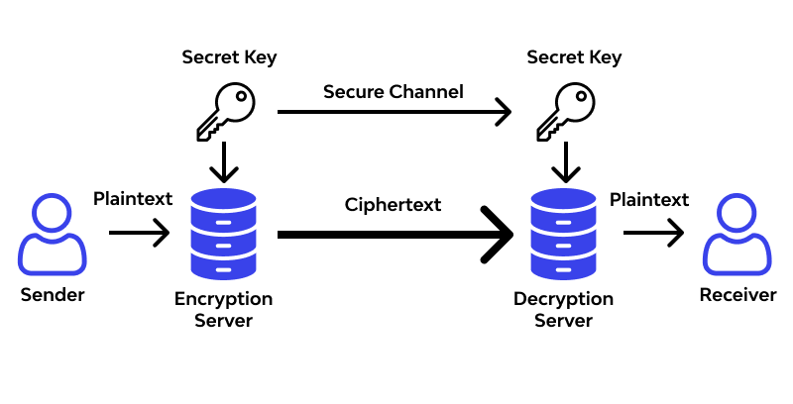
Working of AES

Slide 13
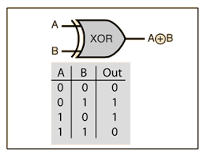
XOR Algorithm
XOR (Exclusive OR) is a symmetrical encryption and decryption method based on the use of the logical with binary operator. It is used for generating parity bits for error checking and fault tolerance.

Slide 14
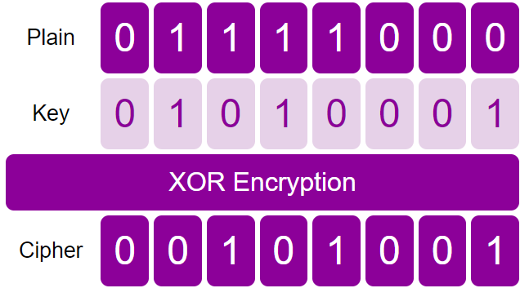
Working of XOR

Slide 15

RC6 Algorithm
RC6 (Rivest Cipher 6) is a block encryption and decryption algorithm based on RC5 algorithm. It is a block cipher with a two-word input (plaintext) and a two-word output (ciphertext) block size.

Slide 16
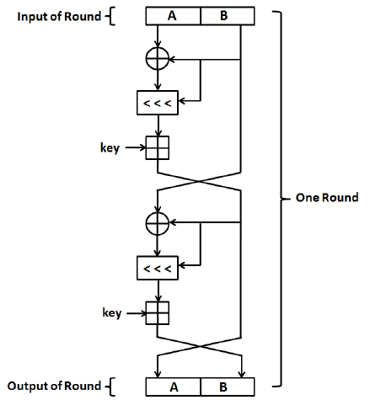
Working of RC6

Slide 17
Technology and Platform to be used
Deployment Platform: - Windows 10 / Windows 11
Application Server: - Apache Server
Software Environment: - Java 19.0.2 and Python 3.11.2
Framework: - Springboot 2.5.3
Database Technologies: - MySQL Workbench (include MySQL Server, Connector Java, Connector Python, MySQL Shell)
Web Development : - HTML5, JavaScript, JSP
Development Tools: - Eclipse IDE for Java Developer, Sublime Text and Pycharm Community Edition

Slide 18
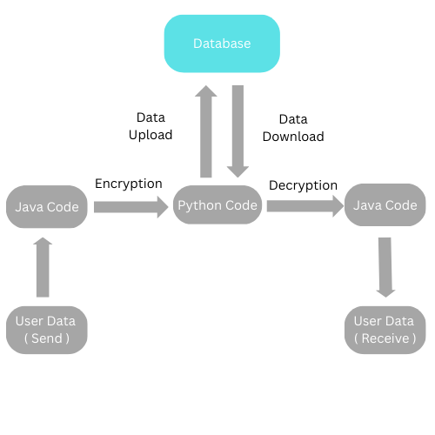
Architectural Flow Diagram (AFD)

Slide 19
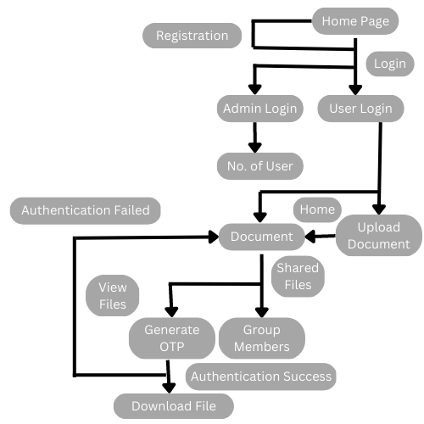
Data Flow Diagram (DFD)

Slide 20
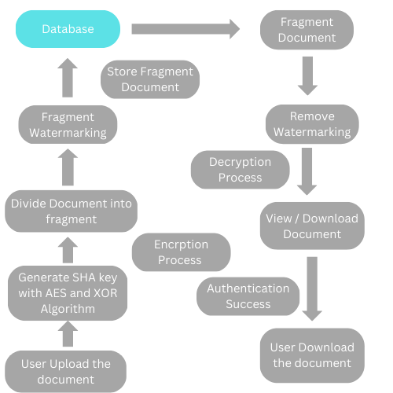
Control Flow Diagram (CFD)

Slide 21




Application of Digital Watermarking
Protection against unauthorized access
Copyright Protection
Authentication
Brand Protection
Metadata Embedding

Slide 22
Demonstrate of this project (Optional)

Slide 23
Conclusion
In this topic we conclude that digital watermarking is important factor for data security which can protect our data from unauthorized access. It is enhance the data security in the form of digital code which is embedded in user file and verify by digital signature. It is difficult to tamper and misuse of information

Slide 24
References
[1] A. Anees, I. Hussain, A. Algarni, and M. Aslam “A robust watermarking scheme for online multimedia copyright protection using new chaotic map.”Hindawi, Security and Communication Networks, Article ID 1840207 2018 pp 1- 20. Aug. 2017
[2] W. Luo, F. Huang, and J. Huang “Edge adaptive image steganography based on LSB matching revisited.” IEEE Trans. On Information Forensics and Security, 5 (2) pp 201-214. Jun. 2010
[3] K. S. Kim, M. J. Lee, H. Y. Lee, and H. K. Lee “Reversible data hiding exploiting spatial correlation between sub-sampled images.”Pattern Recognition, 42 (11) pp 3083-3096 Jan 2009
[4] I. J. Cox, J. Kilian, F. T. Leighton, and T. Shamoon “Secure spread spectrum watermarking for multimedia..”IEEE Transactions on Image Processing, 6 (12) pp 1673- 1687. Feb 1997
[5] G. Xuan, C. Yang, Y. Zhen, Y. Q. Shi, and Z. Ni “Reversible data hiding based on wavelet spread spectrum.”IEEE 6th workshop on Multimedia Signal Processing pp 211-214. Jul. 2004
[6] C. C. Chang, P. Y. Lin “Adaptive watermarking mechanism for rightful ownership protection.”J. Syst. Software, 81 (7) pp 1118-1129. May 2008
[7] G. J. Lee, E. J. Yoon, K. Y. Yoo “A new LSB based digital watermarking scheme with random mapping function.” International Symposium on Ubiquitous Multimedia Computing pp 130-134. Jun. 2008
[8] W. Luo, F. Huang, and J. Huang “Edge adaptive image steganography based on LSB matching revisited.” IEEE Trans. On Information Forensics and Security, 5 (2) pp 201- 214 Mar. 2010

Slide 25
Thank You………

